Slide 1
XAMPP Installation

Slide 2
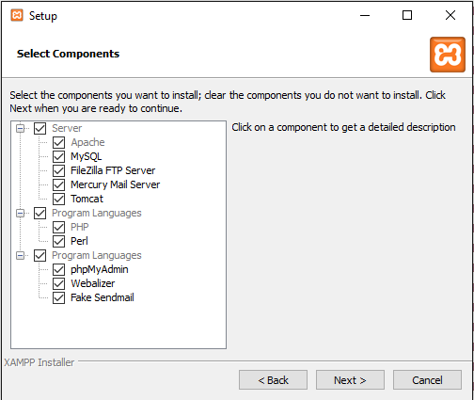
Download the installer and execute

